Slide 1
Revolutionizing Liver Care: Predicting Liver Cirrhosis Using Advanced Machine"
Project Supervisor : Ganesh M
Team ID : LTVIP2025TMID33688 Team Members : Kulluri Jhansi Rani Kunchapu Pravallika Linga Mounika Loka Rama Naga Satya Aparajitha

Slide 2
Abstract— Liver cirrhosis is a highly infectious blood-borne illness that is often asymptomatic in its early stages. As a result, diagnosing and treating patients during the early stages of illness is challenging. As the illness progresses to its latter stages, diagnosis and therapy become increasingly challenging. The purpose of this work is to offer an artificial intelligence system based on machine learning algorithms that may assist healthcare practitioners in making an early diagnosis of liver cirrhosis. Various machine learning algorithms are being developed with this in mind to forecast the possibility of a liver cirrhosis infection.

Slide 3
In this research, three alternative models for reliable prediction were produced by training three separate models employing a range of physiological parameters and machine learning methods such as Support Vector Machine, Decision Tree Classification, and Random Forest Classification. Random Forest was the best performing algorithm in this challenge, with an accuracy of around 97 percent. The open-access Liver Cirrhosis data dataset was employed in the method's development. The accuracy percentage of the models employed in this study is substantially greater than in earlier research, showing that the models utilized in this study are more dependable. Several model comparisons have shown their robustness, and the scheme may be determined from the research analysis.

Slide 4
Liver cirrhosis is a disease that affects the whole human population. It is a blood-borne illness that spreads by direct contact with infected people's blood or blood-containing bodily fluids. Almost 71 million individuals worldwide are chronically unwell as a result of this condition, and an estimated 399,000 people died from it in 2016 [1]. According to the WHO (World Health Organization), liver cirrhosis is a worldwide illness. According to the research conducted by the WHO, 3–4 million individuals get infected with this virus each year. When compared to wealthy nations in Europe poor developing Asian and African countries have the greatest frequency of this virus. The number of people suffering from chronic illnesses is increasing in countries such as Pakistan, China, and Egypt [2-4]. Liver cirrhosis virus symptoms appear much later in the disease's progression. Approximately 80% of infected patients do not experience any symptoms after contracting an infection in the early stages, resulting in greater liver damage and higher fatality rates.

Slide 5
<!DOCTYPE html> <html lang="en"> <head> <meta charset="UTF-8"> <title>Liver Cirrhosis Prediction</title> </head> <body> <h1>Welcome to Liver Cirrhosis Prediction System</h1> <p>This page will allow users to upload data and see prediction results.</p> <form action="/predict" method="post" enctype="multipart/form-data"> <label for="file">Upload CSV file:</label> <input type="file" name="file" id="file" accept=".csv"> <button type="submit">Predict</button> </form> </body> </html>

Slide 6
Procedure and Experimental Methodology
A. Proposed System
Once the data has been analyzed, it may be used to build a model. A preprocessed dataset and machine learning algorithms are required for model creation. Decision Tree Classification, Random Forest Classification, and Support Vector Machine (SVM) are some of the techniques used. The accuracy metrics Accuracy Score, Precision Score, Recall Score, and F1 Score are used to evaluate the four alternative models once they have been created. Figure depicts the proposed system's block diagram.

Slide 7
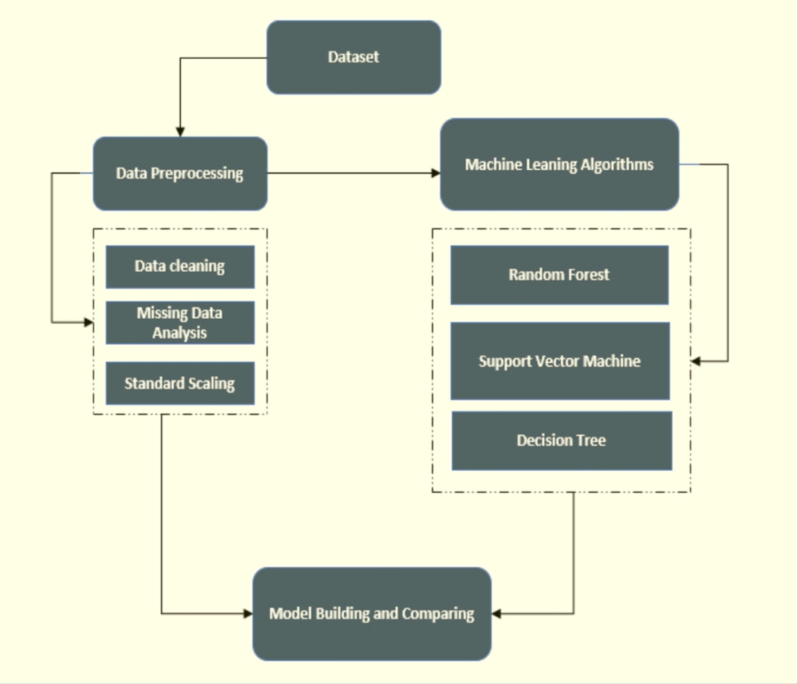

Slide 8
B. Dataset
The Liver cirrhosis Dataset [41] was utilized to conduct the research. It has 615 rows and 13 columns in this dataset Either '1' or '0' is returned in the 'Category' output field. Values of zero and one reflect the presence or absence of Liver cirrhosis (LD) in the patient. It is more likely to see a zero in the output column than it is to see a one in the same column. Data pre-processing is used to ensure that the data is evenly distributed. Prior to pre-processing, the total number of LD and healthy data is shown in Figure

Slide 9
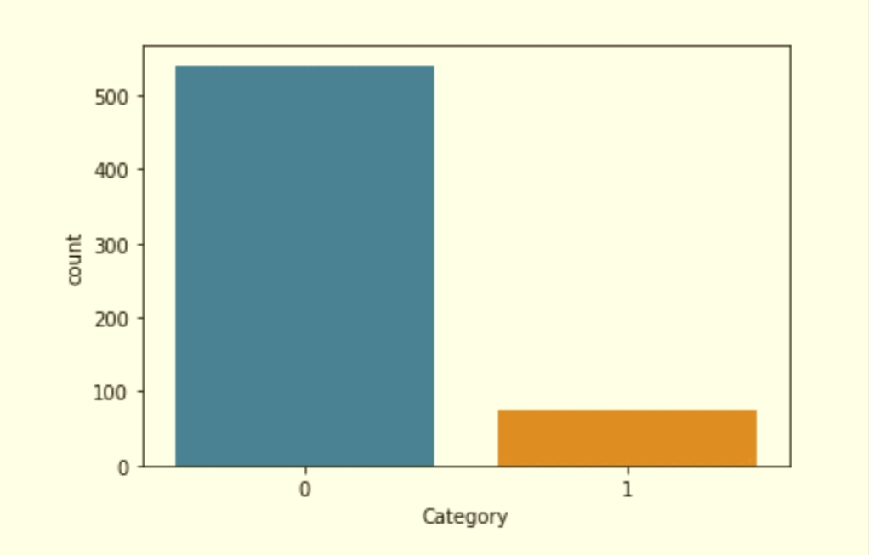

Slide 10
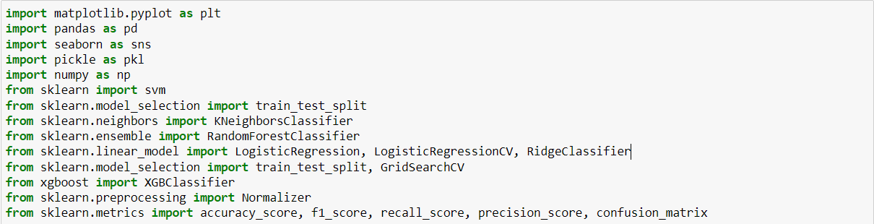

Slide 11
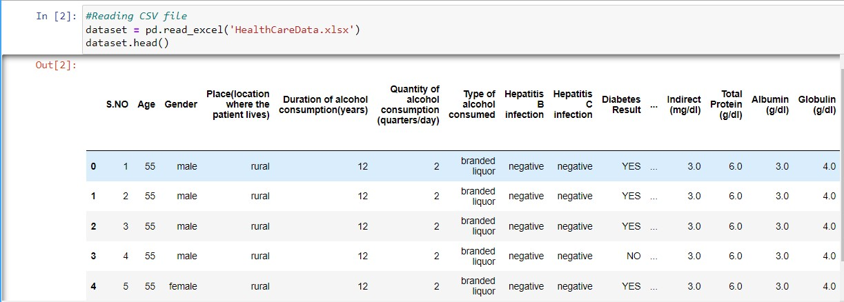

Slide 12
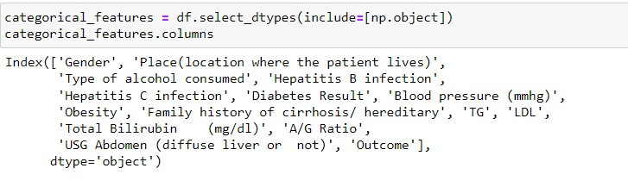

Slide 13
1. Random Forest
Random Forest Classification was used as the algorithm for classification. Multiple decision trees, each trained on a random sampling of data, make form a Random Forest. In training, these trees are built, which yields the trees' outputs. This algorithm uses a procedure known as "vote" to establish its final prediction. To use this method, each decision tree must choose between two possible outcomes (here, 'LD' and 'Healthy'). The class with the highest votes is chosen as the final prediction by the random forest method. a section in Figure 4 depicts a random forest classification diagram.

Slide 14
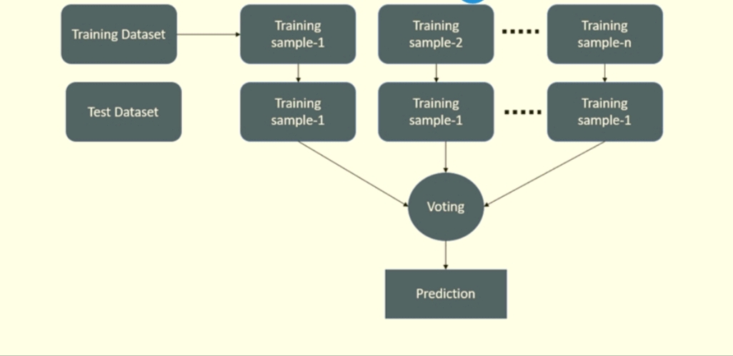

Slide 15
2) Descision Tree
The use of Decision Trees can be applied to both regression and classification problems. Because the input variables have a related output variable, this is a supervised learning approach. A tree can be seen in its resemblance. A specific parameter is used to divide the data constantly in this method. Both the Decision and Leaf nodes form the core of a decision tree. Nodes 1 and 2 are responsible for dividing data, whereas nodes 3 and 4 are responsible for producing the final output. Using Figure 5, we can see the Decision Tree Classifier's basic structure and operation.

Slide 16
